Slide 1

Trajectory Prediction of pedestrians
Institute of informatics

Slide 2
DataSet ETH
The data set contains multiple files seq_eth and seq_hotel
I had chosen the data set name seq_eth.
The given dataset is in text format. In this data set we had various text format files like obsmat,groups, H.txt, destinations , biwi_eth_10fps.
There were different columns in the data set and named as frame_number, pedistrain_ID, pos_x,pos_z, 'pos_y', 'v_x', 'v_z', 'v_y’.
However, pos_z and v_z (direction perpendicular to the ground) are not used. The positions and velocities are in meters and are obtained with the homography matrix stored in H.txt.

Slide 3
So in total, there were 6 columns with 8908 entries.
Here there are some other folders that describe destinations of the pedestrians, Groups of the pedestrians, and pedestrians at 10 frames per second.
In the complete folder of two groups we had 45 entries for seq_hotel and 65 for seq_eth

Slide 4
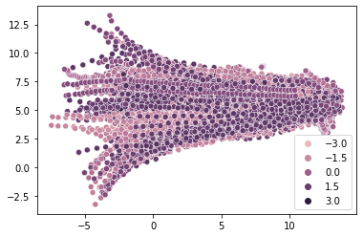
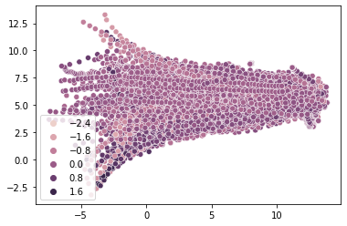
visualization the position of x and y in the dataset with respect to X and y direction velocity

Slide 5
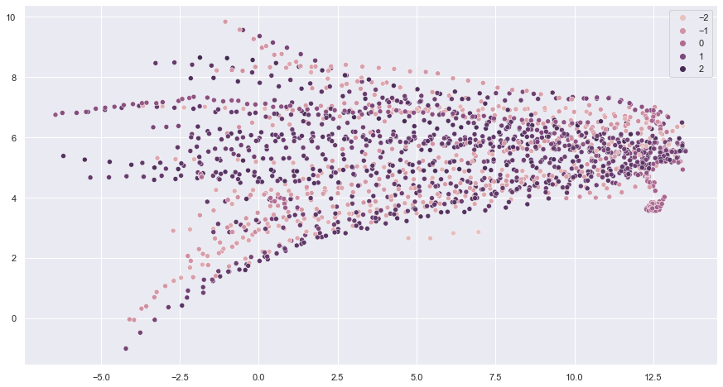
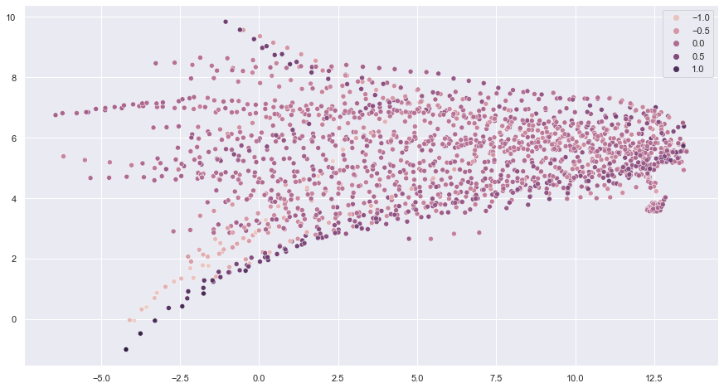
People walking in groups 1&2
Notes:
We, can clearly see the difference between image 1&2wherei have tried to visualize whole dataset now when we grouped the data frame with the help of the padesterian id we can see there is a very very much difference there.
Velocity is very similar to the previous figures but, here all the entities we are looking at are the grouped entity.

Slide 6
Conclusion :
We can see that the velocity concerning the x-axis is much stronger than the velocity concerning the y-axis, which means people are moving toward the X-axis much faster than those on the y-axis.

Slide 7
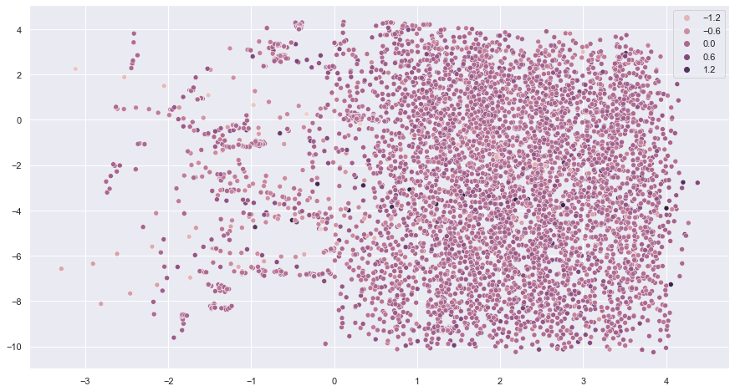
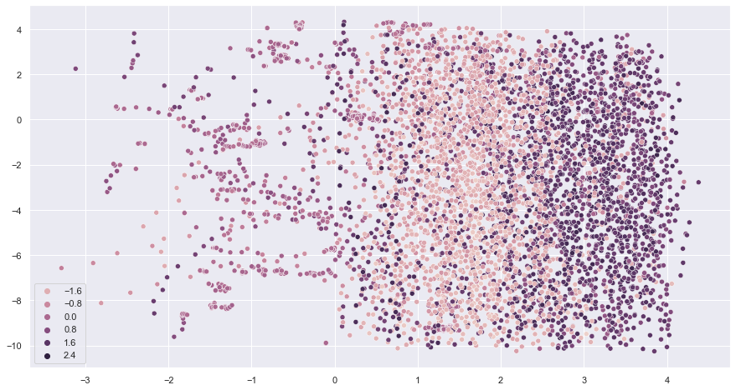
Seq_hotel
Notes:
There where total 6544 entries in this folder

Slide 8
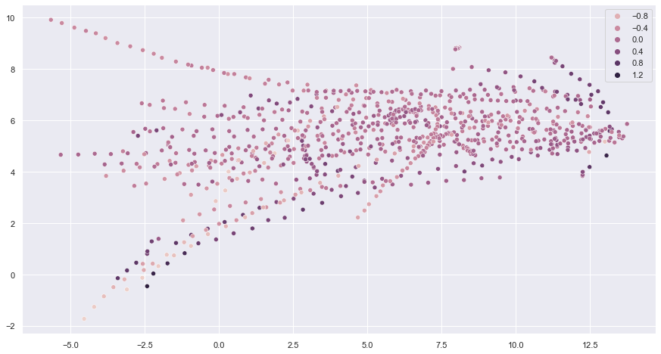
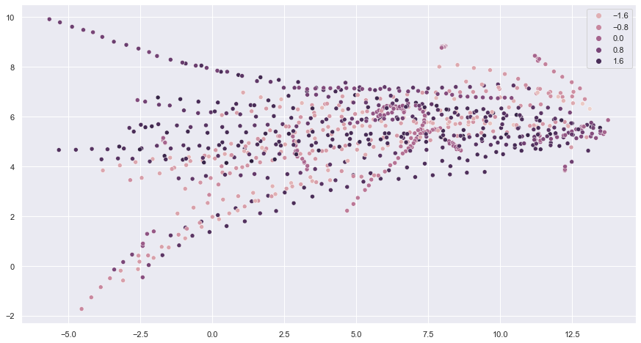
Grouping of seq_hotel
Notes:
But now when we have grouped the dataset we can clearly see the difference we can see the people in group walking in which direction and the velocity respectvely.

Slide 9
Thank you..

